Slide 1
Enhancing Customer Experience in Pillage Cinemas A Prototype Task-Oriented Dialog System powered by the Rasa Framework
Elissavet Beka

Slide 2

Table of contents
Introduction
Scope of the Virtual Assistant
Data Utilization
How to Run the System
Dialog Flow: Checking Available Films
Dialog Flow: Booking Tickets
Dialog Flow: Cancelling Tickets
Challenges in Dialog Flow
Next Steps for Improvement
Conclusion

Slide 3


Introduction
Welcome to Pillage Cinemas, where the magic of movies comes to life!
As a premier destination for movie enthusiasts of all ages, we pride ourselves on creating an unforgettable cinematic experience.
Our theaters are equipped with state-of-the-art technology, ensuring that every film is presented in stunning clarity and sound.
We offer a diverse selection of blockbusters, independent films, and family-friendly options, catering to various tastes and preferences. Join us! Our chatbot is here to serve you!!
Pillage Cinemas

Slide 4


Scope of the Virtual Assistant
On-the-fly Information about Available Screenings
Information Regarding Cancellation Policies
Online Ticket Booking
Seamless process for selecting films, theaters, and showtimes.
User-friendly interface for confirming ticket purchases.
Real-time updates on movie availability and showtimes.
Detailed film information including genre, director, and runtime.
Clear guidelines on cancellation procedures. Options for refunds, including full refunds, coupons, and arcade credits.

Slide 5
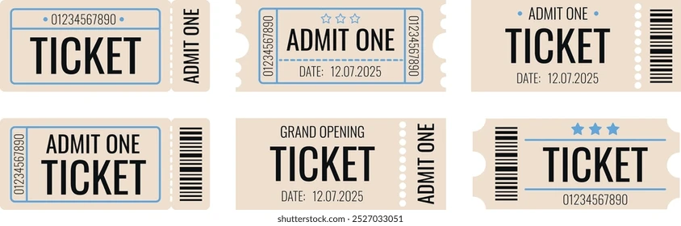
Data Utilization
External Dataset Utilization
Leverage the IMDb Top 1000 dataset to access comprehensive film metadata.
Metadata includes essential details such as title, director, actors, release year, and genre.
Synthetic Data Generation
Simulate cinema-specific information to enhance user interaction.
Generated data covers aspects like:
Theaters showing films
Showtimes and screening rooms
Admission prices and available seats

Slide 6



How to Run the System
Train the Model
Start the Rasa Shell
Install Requirements
Βegin by installing the necessary dependencies using the command `pip install -r requirements.txt` to ensure all required packages are available for the system to function properly.
Next, train the model to prepare it for handling user interactions and processing requests by executing the command `rasa train`. This step is crucial for enabling the virtual assistant to understand and respond accurately.
Finally, launch the Rasa shell with the command `rasa shell` to initiate the virtual assistant, allowing it to interact with users and assist them with tasks such as ticket booking and providing movie information.

Slide 7



Dialog Flow: Checking Available Films
The bot welcomes the user and offers assistance in finding a movie.
The user asks the bot for movie recommendations for the evening.
User Initiates Conversation
The bot presents a list of available films for screening, including titles such as 'Shutter Island,'
The user selects a specific movie from the list and requests additional details about.

Slide 8



Dialog Flow: Booking Tickets
User Initiates Booking
Bot Asks for Movie Selection
User Selects a Movie
The user starts the process by expressing the desire to book a ticket.
The user starts the process by expressing the desire to book a ticket.
The user selects a movie from the provided options, such as 'Giant' or 'Joker'.

Slide 9
Dialog Flow: Cancelling Tickets
User Requests Cancellation
Bot Informs About Offline Cancellation
User Asks for More Details
Bot Provides Cancellation Options
The user initiates the process by asking to cancel their tickets.
The bot responds by informing the user that cancellations cannot be made online and must be handled in-person at the theater.
The user expresses interest in understanding the cancellation process further.
The bot outlines the available options for refunds, including a full refund, a coupon for future ticket purchases

Slide 10
Challenges in Dialog Flow
Adaptive Dialog Flow
Need for the system to extract information from user inputs effectively.
Implementation of slots and forms to enhance information retrieval.
Handling Incorrect User Input
Development of a mechanism to interrupt the dialog flow when invalid information is provided.
Ensuring a seamless restart of the dialog process to maintain user engagement.

Slide 11

Next Steps for Improvement
Integrate a Real-World Database: Enhance the virtual assistant's capabilities by connecting to a live database for real-time information.
Implement Adaptive Fallback Mechanisms:
Develop smarter fallback strategies to handle incorrect user inputs and guide users back to the correct dialog flow.
Support Multiple Languages: Expand the virtual assistant's accessibility by incorporating multilingual support to cater to a diverse customer base.

Slide 12

Conclusion
The assistant efficiently handles online ticket bookings, provides real-time information about screenings, and explains cancellation policies, ensuring a seamless user experience.

Slide 13
THANK YOU FOR YOUR TIME!

